Slide 1
Using AI to strengthen VDAB in becoming a trusted advisor

Slide 2
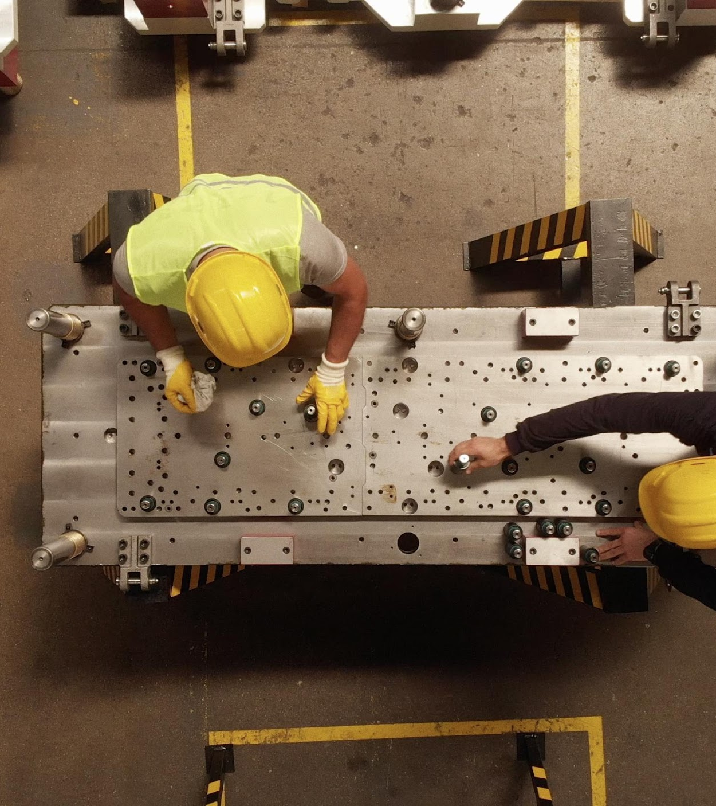
Today
Today
Journey of AI @ VDAB so far
Challenges and learnings
Looking ahead
Journey of AI@VDAB so far
Ethics Council
Examples
Suggestions?

Slide 3
Journey of AI@VDAB so far

Slide 4
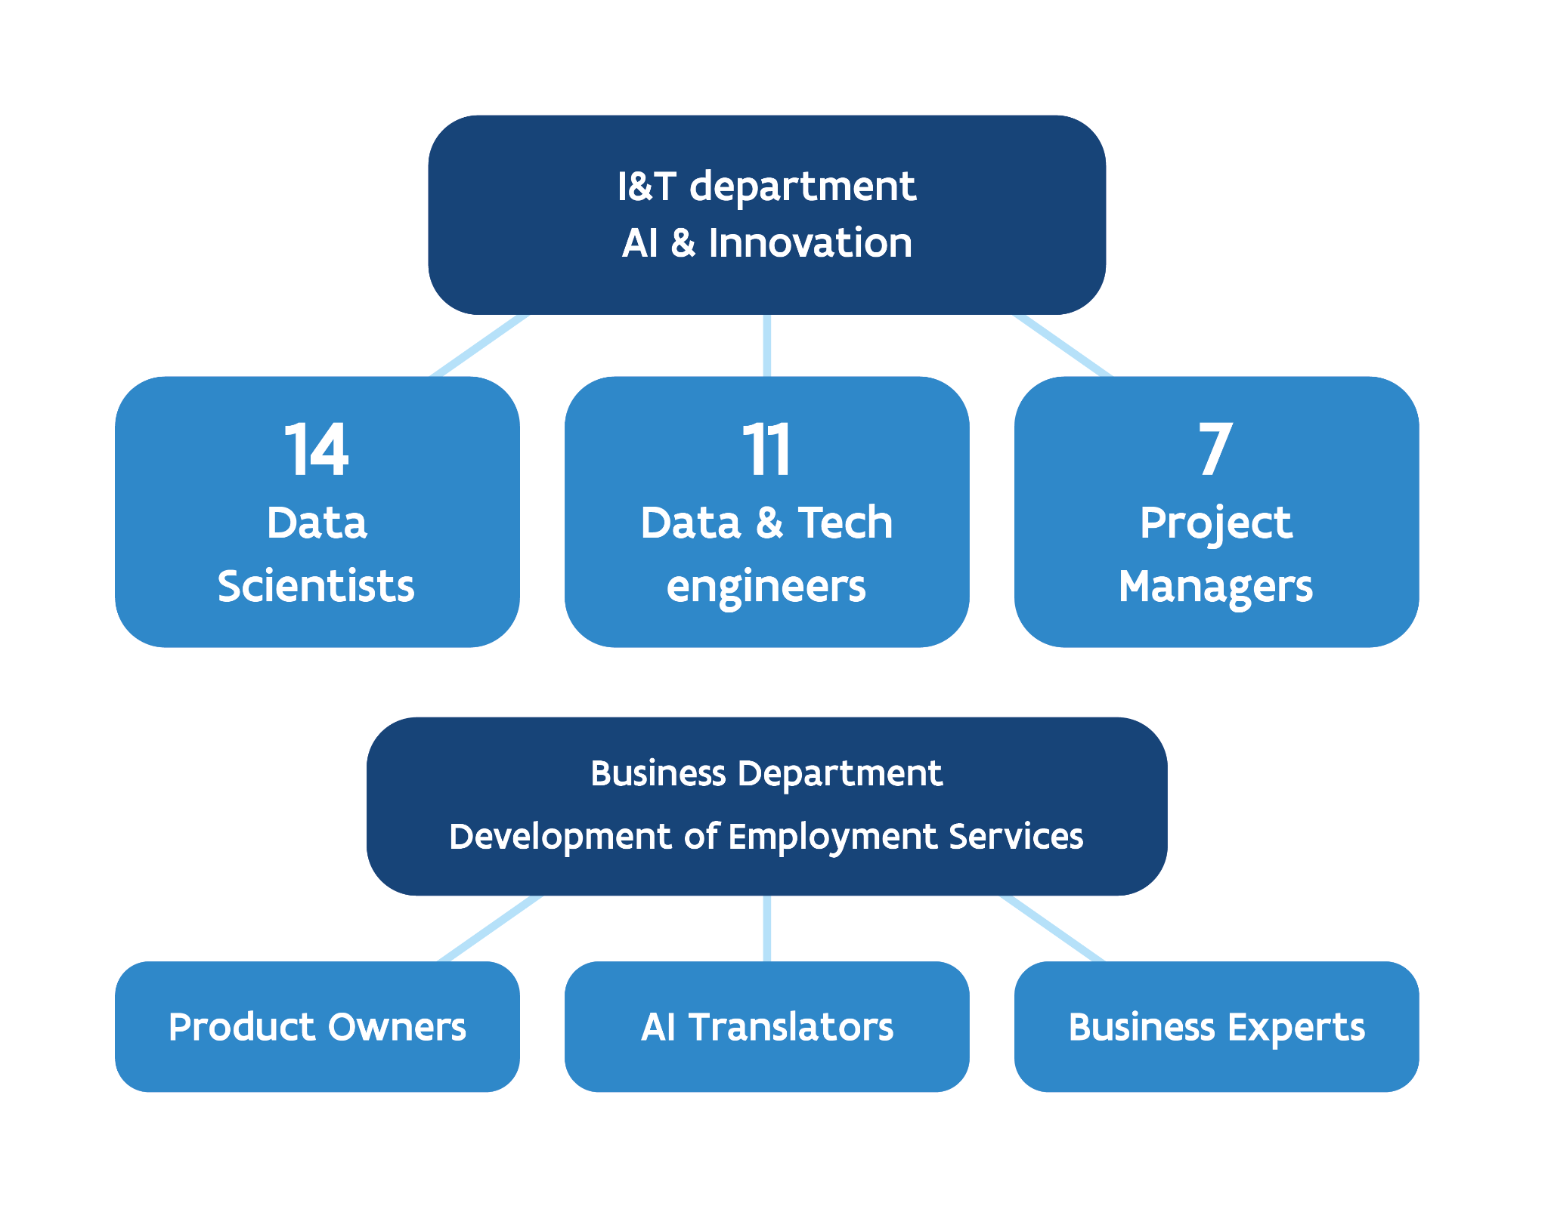
AI & Innovation at VDAB
Team has grown from an innovation lab to a mature AI team +30 professionals
2023: AI Center of Excellence
2016: Innovation lab
12
11
6
3
collaborators

Slide 5
Freedom -independent of existing structures and conventions, is necessary for innovation
Innovation to tackle VDAB’s challenges
Innovation to tackle VDAB’s challenges
Freedom - independent of existing structures and conventions, is necessary for innovation
Innovation to tackle future challenges
Freedom to experiment is necessary
Openness and transparency are crucial

Slide 6
The AI solutions support VDAB’s core targets
Mapping of the AI solutions on VDAB’s main products
* In production
Filling in job positions
* Gelijkaardige vacatures
Kans vacature-invulling
Externalisatie AI
Ondersteunende assets
Verbetering Vind een Job
* Beroepzoeker
Kandidatenbereik
* Talent API
Interactie opleiding en werkgever
Interactie werkgever en burger
Skill trends
* Jobbereik
* Jobbereik
* VDAB skill Framework
Analyse opleidingsdata
*Competentiecheck
* Oriënt 2.0
* Datagedreven Competent
Slimme tips
Loopbaanpaden
Education
* Kans op werk
prioritering werkzoekenden
Optimisation of career trajectory of citizens
Interactie opleiding en burger
Verbetering Vind een Opleiding
* Opleidingssuggesties
Notes:
6

Slide 7
AI realisations over time
2018
2019
2020
2021
2022
2023
23
19
AI expands to 23 realisations
Kans op werk
TalentAPI Profiel → Job
TalentAPI Job → Job
Graph database
Beroepzoeker C1
Jobbereik
Orient
Jobmap
Bias analyse Orient
Beroepzoeker C2
Datagedreven Competent
Diverse annotatietools
Competentiezoeker 2.0 voor CV’s
Data pipelines Advertsdata
Skill Navigator
Jobbereik Opleidingsuggesties
Skill tagger API
Skilltag based Jobbereik
Competentiecheck
CV scanner
Publieke Skill tagger API
Publieke Skill Navigator API
Motivering weigering opleidingen
Bias analyse Kans op Werk
Bias analyse TalentAPI
14
AI expands to 19 realisations
Kans op werk
TalentAPI Profiel → Job
TalentAPI Job → Job
Jobnet
Graph database
Activiteitsgraad
Beroepzoeker C1
Jobbereik
Orient
Jobmap
Bias analyse Orient
Beroepzoeker C2
Datagedreven Competent
Diverse annotatietools
Competentiezoeker 2.0 voor CV’s
Data pipelines Advertsdata
Skill Navigator
Jobbereik Opleidingsuggesties
Skill tagger API
Skilltag based Jobbereik
Competentiecheck
8
5
AI expands to 14 realisation
Kans op werk
Jobnet
Graph database
Activiteitsgraad
Beroepzoeker C1
Jobbereik
Orient
Jobmap
Bias analyse Orient
Beroepzoeker C2
Datagedreven Competent
Diverse annotatietools
Competentiezoeker 2.0 voor CV’s
Data pipelines Advertsdata
AI expands to 8 realisations
Kans op werk
Jobnet
Graph database
Activiteitsgraad
Beroepzoeker C1
Jobbereik
Orient
Jobmap
2
AI expands to 5 realisations
Kans op werk
Jobnet
Graph database
Activiteitsgraad
Beroepzoeker C1
First realisations
Kans op werk
Jobnet
Notes:
7

Slide 8
Optimization of VDAB’s contact strategy at the human-digital layer
Identify who’s most in urgence for help
“Thanks to AI, we have a capacity gain of 7 FTE’s”
Manager Service line

Slide 9
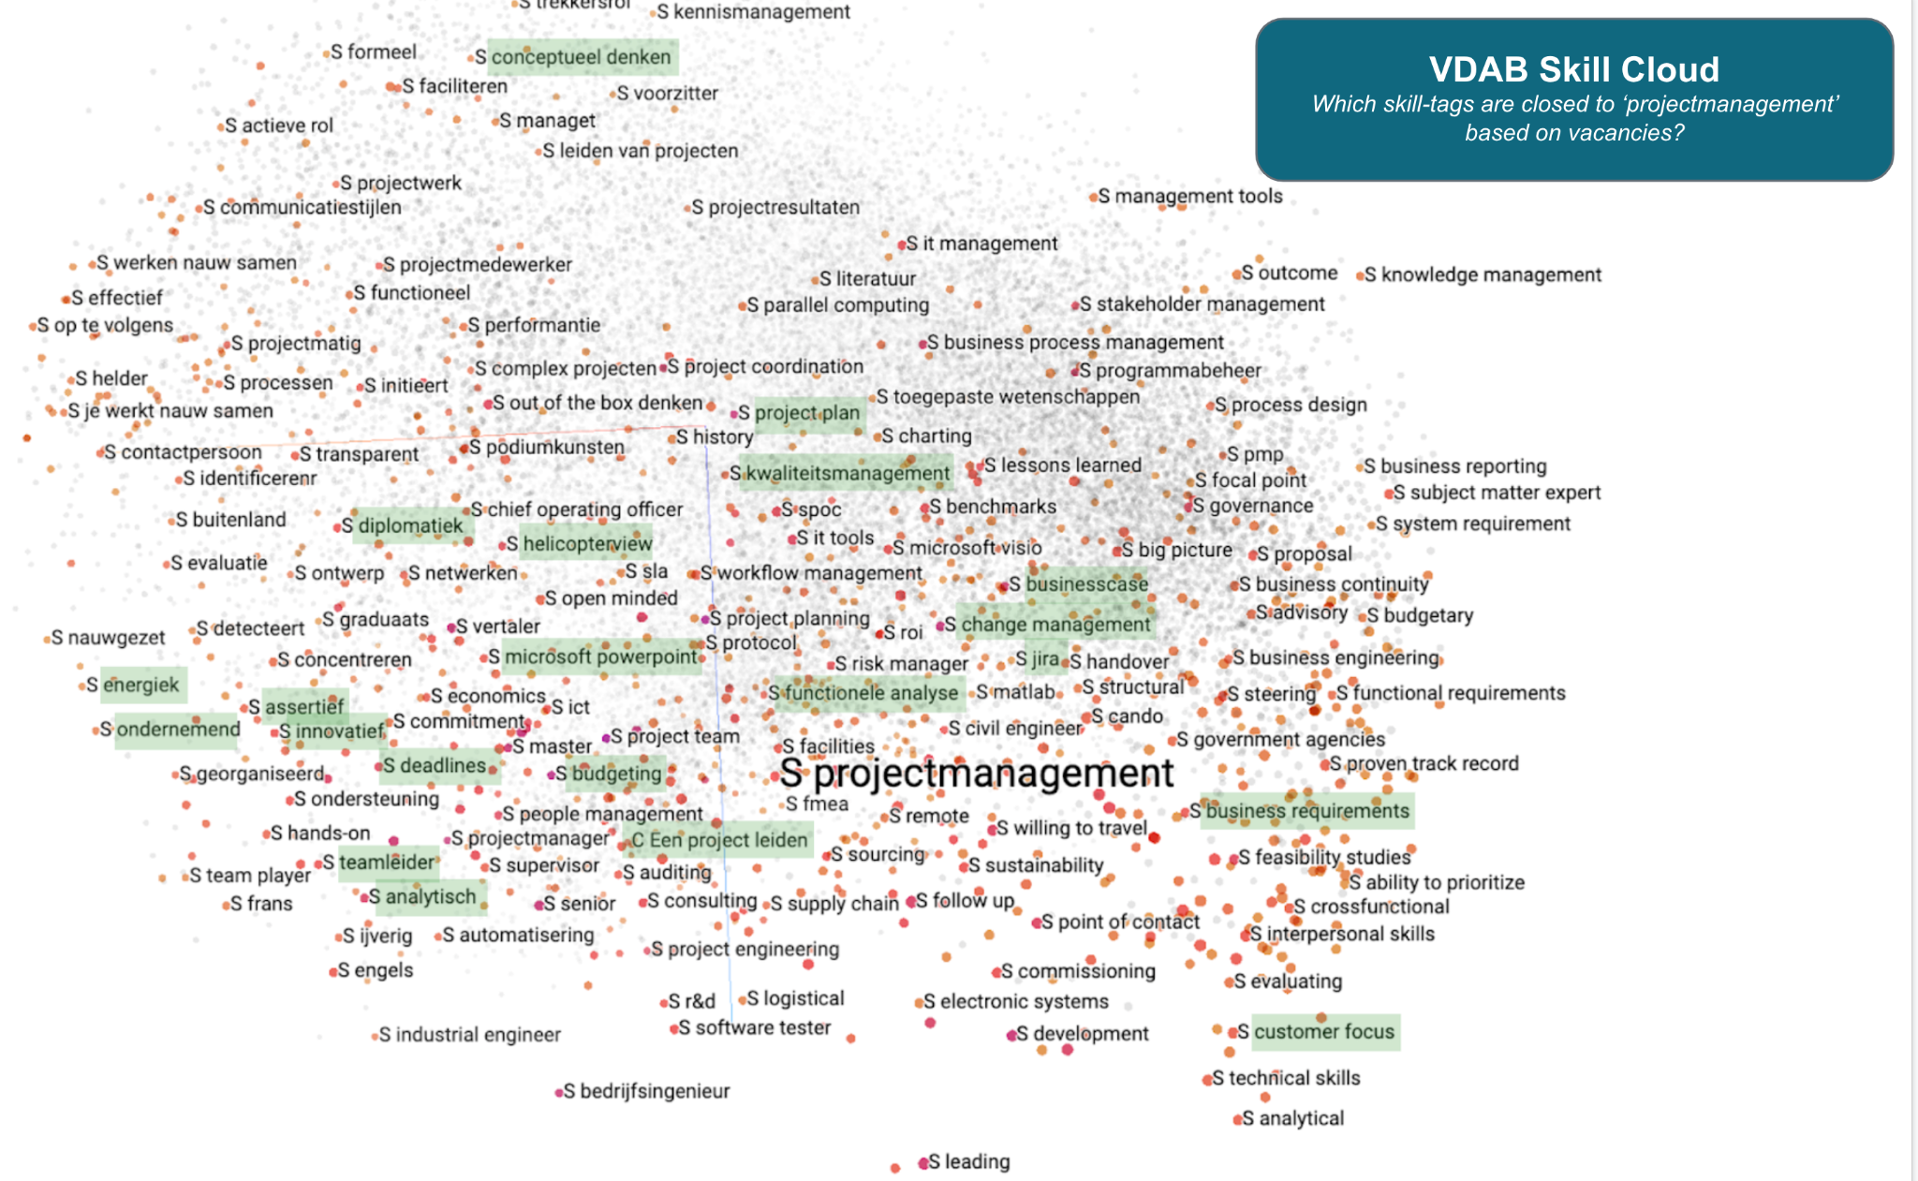
Data enrichment with VDAB’s Skill Framework
VDAB Skill Framework is the foundation of VDAB’s AI solutions:
a data-driven collection of skills that are detected from different labour market relevant sources

Slide 10
Jobbereik
Self-orientation tool to widen the citizen’s work horizon
35.471 active users during 2023

Slide 11
Ethics Council

Slide 12
Trust

Slide 13
Trust
is key to realise business impact

Slide 14
Trust
In 2022, VDAB established Belgium's first Ethics Council on the use of data & AI.
is key to realise business impact
Aim is to help VDAB to be and remain ethically sound while leveraging the potential of data.

Slide 15
Ethics Council
Mandate
The Ethics Council
Works on behalf of the Board of Directors
Gives independent advice, and functions as a sounding board for VDAB
Scope
Ethical issues related to AI, profiling and automated decision making
Agenda topics from input across the organisation, and upon request from external council members.

Slide 16
Ethics Council
Members
Member | VDAB or external | Role / Expertise domain
Jan De Schepper - Chair | external | Operational expertise, Chairman and Executive Board Member
Danielle Jacobs | external | Transversal domain expertise, CEO Beltug - Association CIOs & Digital Technology leaders
Tuba Bircan | external | Social Sciences expertise, Computational Social Scientist, VUB
Nathalie Smuha | external | Legal expertise: Scholar, Lawyer, Philosopher | KU Leuven & Quinz Lawyers (AI & Digital Tech)
Lode Lauwaert | external | Ethical Expertise, Professor of Philosophy of Technology at KU Leuven - Institute of Philosophy
Bram Lievrouw Replacement Cindy De Waele | VDAB | Director of service development
Karina Van Den Broeck Replacement Katrien Vereecken | VDAB | Functional customer service, VDAB integrity officer
Jan Dobbenie Replacement Amedee Audooren | VDAB | CIO, director Information & Technology

Slide 17
Key outcomes
Open, constructive and positives discussions
Diverse team and sounding board for VDAB
AI maturity of VDAB is high
VDAB is a leader and example regarding AI
23 solutions in operation
Comprehensive AI governance and risk management framework, carried by business- and IT team cooperation
Interests from within and outside Europe: visits to and from Luxembourg, Norway, Denmark, the Netherlands, Japan, Costa Rica,...
Increased and improved communication is important

Slide 18
Examples

Slide 19
Job chance (KansOpWerk)

Slide 20
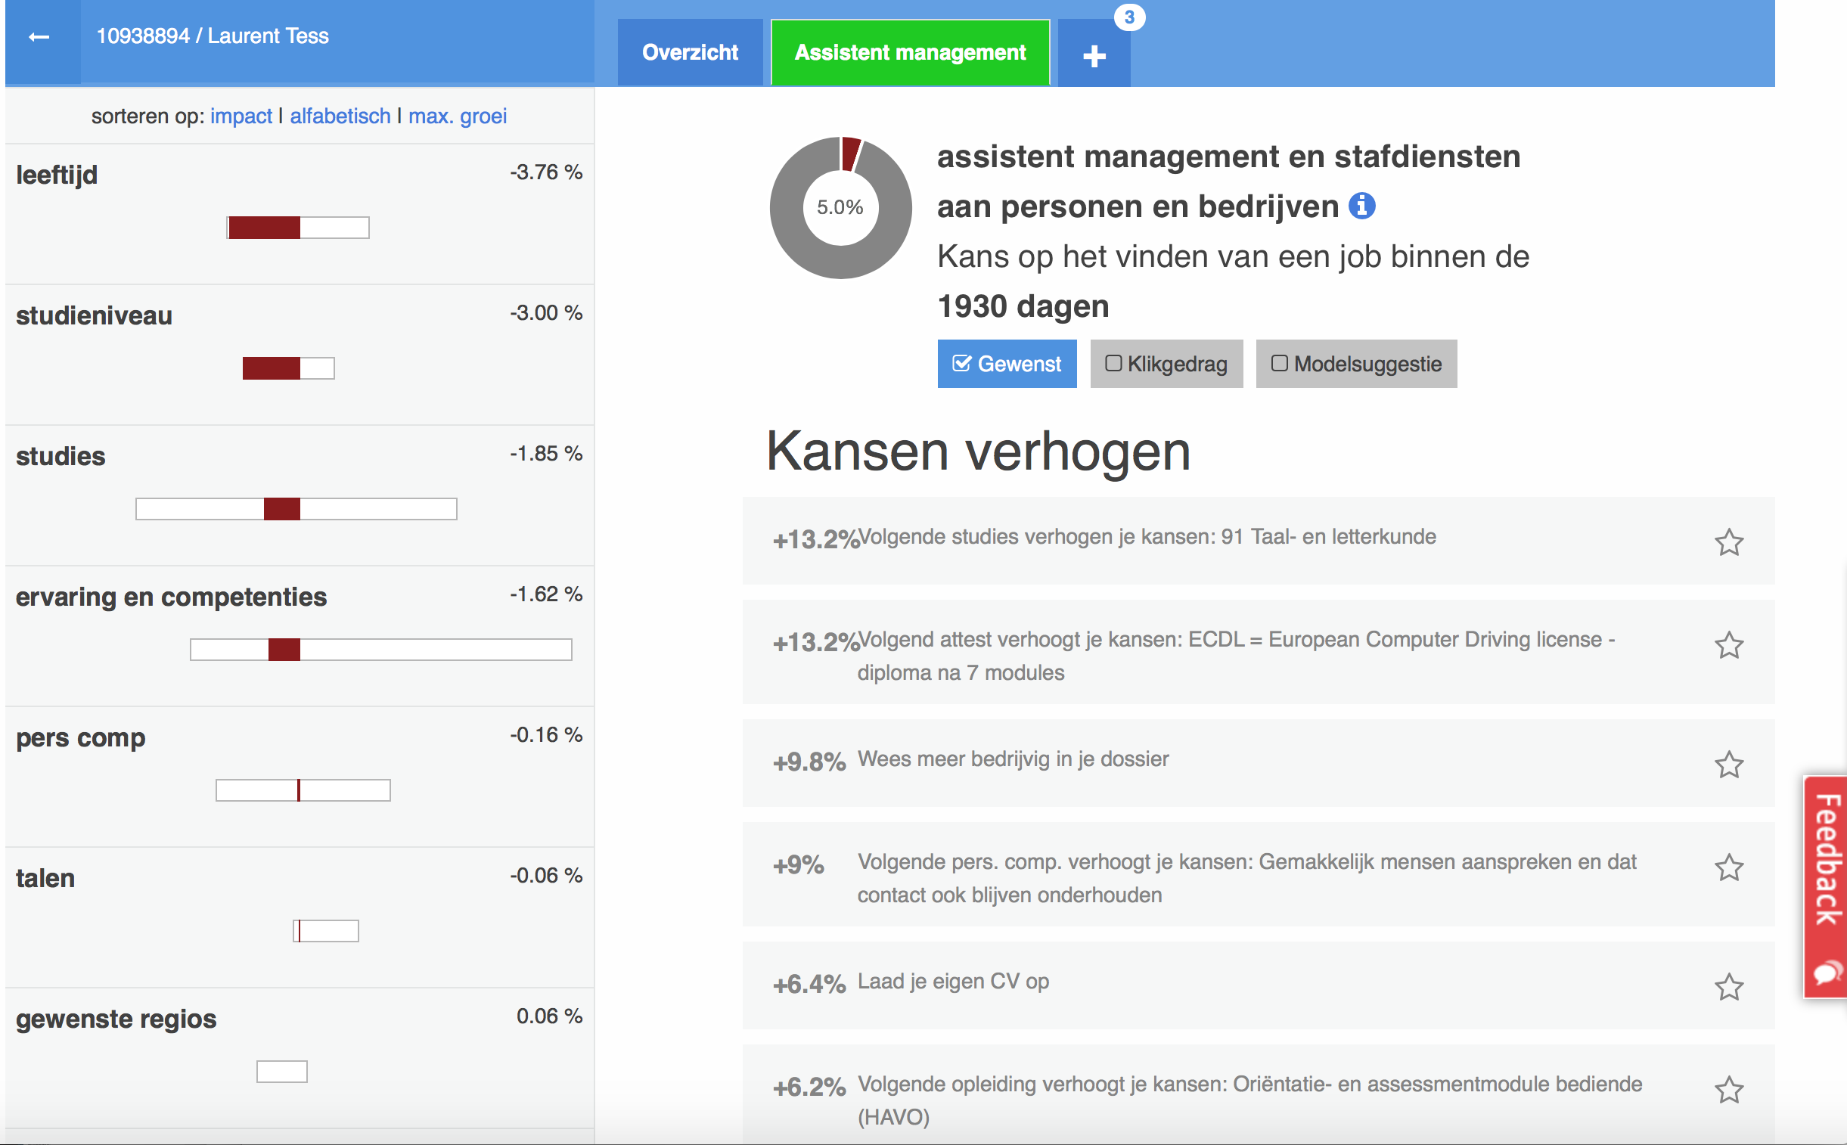
Job chance: history
One of the first AI-projects within VDAB
First prototype in 2017 (“Next steps dashboard, containing job chances, but also recommendations)
“Job chance” in production since october 2018
Since then almost everyday an estimate of de job chances for all jobseekers
xxxx

Slide 21
Job chance: Idea
The probability that a jobseeker will find work
of at least 28 consecutive days,
within 6 months,
Objective measurement of distance to the labour market
Everyday new predictions, so if the data of a client changes, the next day there will be a different prediction

Slide 22
Job chance: Data
Data:
Current and previous unemployment spells info
Dossier data (Languages, wished jobs and regions, studies)
Client information (age)
Activity on MijnLoopbaan (updating CV, updating wished jobs and competencies, …)
Work Experience (employed and self-employed)
Future data?
Not: Gender, nationality, …
Maybe: services, trainings, ...

Slide 23
Job chance: Technical
Random forest model
Training, ETL and predictions all in PySpark
Orchestrated by Airflow

Slide 24
Job chance: Use cases
supporting the call-centre for the new contact strategy
Most important: the contact strategy
Since october 2018: “Digital” first contact strategy
New jobseekers will get a call from our call-centre after 2-3 weeks of unemployment
Job chance is being used to prioritise these clients on the calling-lists
Percentages are converted to green/orange/red
green: job chance > 65%
orange: 35% < job chance < 65%
red: job chance < 35%
Red called first, then orange, then green

Slide 25
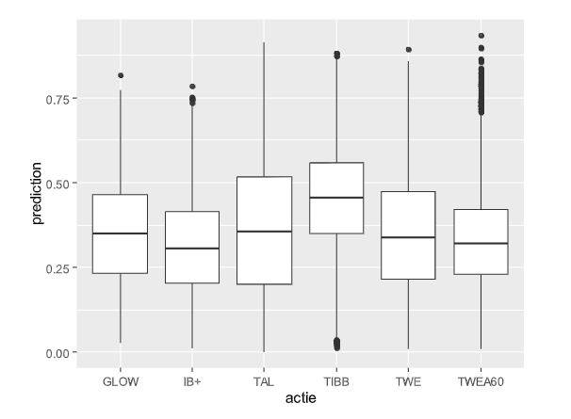
Job chance: Use cases
Other use cases
For the other use-cases, the Job chance on a certain date (e.g. the start of a certain VDAB action) is used to summarize the position of the clients
A few reports produced by the monitoring department
Internal and external research (VDAB, universities, research organizations, …)

Slide 26
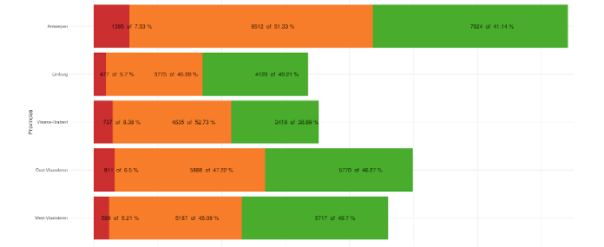
Across target groups
Data can be used for several statistical analyses
1 square == 150 jobseekers
1 square == 150 jobseekers
1 square == 150 jobseekers
1 square == 150 jobseekers
1 square == 150 jobseekers
1 square == 150 jobseekers
Probability to find a job within 6 months for new jobseekers
Highly educated
Middle educated
Age: < 25 years
Shortly educated
Age: >= 25 years and < 55 years
Age: >= 55 years
Provinces
Focus on Jobseekers, across traditional target groups

Slide 27
Validation of the results
“has found a job” versus color
What is the client status 6 months after being on the calling lists?
Green clients find jobs much more often after 6 months
 | Green (job chance >65%) | Orange (35%< job chance < 65%) | Red (job chance < 35%)
Found job | 69% | 50% | 25%
Still looking | 25% | 42% | 62%
Other (e.g. sick) | 6% | 9% | 8%

Slide 28
Jobbereik

Slide 29
Challenge
The labour market is complex and dynamic
We want to offer insights into skills and their link to occupations
In so doing, we should stay on track with the labour market, where the necessary skills for an occupation change over time
The current skills do not necessarily guarantee a durable career
We want to build a mindset of lifelong learning
And be a guide through the training landscape of VDAB and beyond

Slide 30
So we have built…
A user-friendly, intuitive application that
assists our users to think in terms of skills
offers insights in one’s position on the labour market
shows which occupations align with one’s skills and to what degree
helps with a targeted search for further training

Slide 31
Core functionality

Slide 32
To this end, we need…
A language that expresses skills: what am I capable of, do I know, …?
Links between occupations and skills: what do I need for this occupation?
Links between training programs and skills: what can I learn?
A method to suggest relevant training: which courses fit my needs?

Slide 33
To this end, we need…
A language that expresses skills: what am I capable of, do I know, …?
Links between occupations and skills: what do I need for this occupation?
Links between training programs and skills: what can I learn?
A method to suggest relevant training: which courses fit my needs?

Slide 34
VDAB Skill Framework
“A data driven collection of skills, detected from different sources such as vacancies, CV’s, ESCO, Competent, wikipedia”
Components
Skill Cloud: Graph of skill tags
45.000 unique skills linked to plusminus 3 synonyms (in total 180.000 concepts)
Language of the citizen and employer
Linked to types (technical skills, soft skills, languages, etc)
Skill tagger: algorithm to identify skills from free text
Skill seeker: algorithm to identify new skills
Skill Navigator API: model that calculates contextual links between skills, competences, occupations and functions
Intelligent search engine that is able to convert natural language to skills, competences, occupations or functions
This search engine can be used to calculate similarities between skills and competences

Slide 35
We also need…
A language that expresses skills: what am I capable of, do I know, …?
Links between occupations and skills: what do I need for this occupation?
Links between training programs and skills: what can I learn?
A method to suggest relevant training: which courses fit my needs?

Slide 36
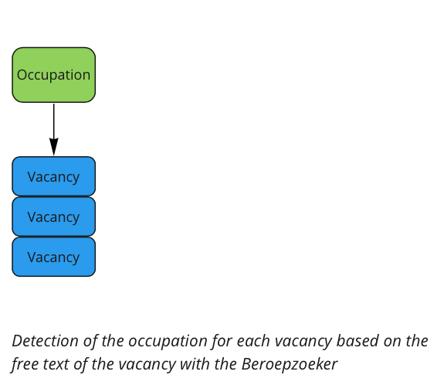
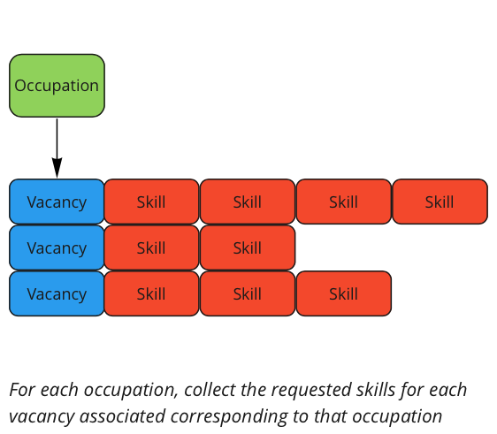
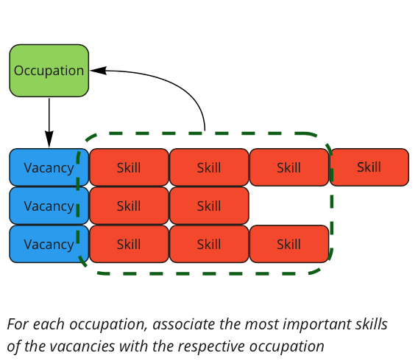
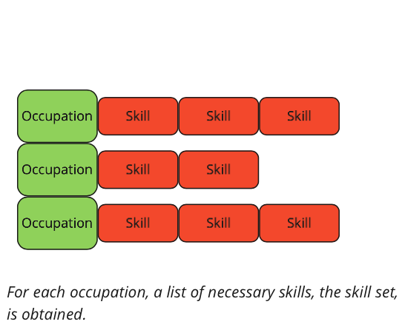
Skills for occupations

Slide 37
We also need…
A language that expresses skills: what am I capable of, do I know, …?
Links between occupations and skills: what do I need for this occupation?
Links between training programs and skills: what can I learn?
A method to suggest relevant training: which courses fit my needs?

Slide 38
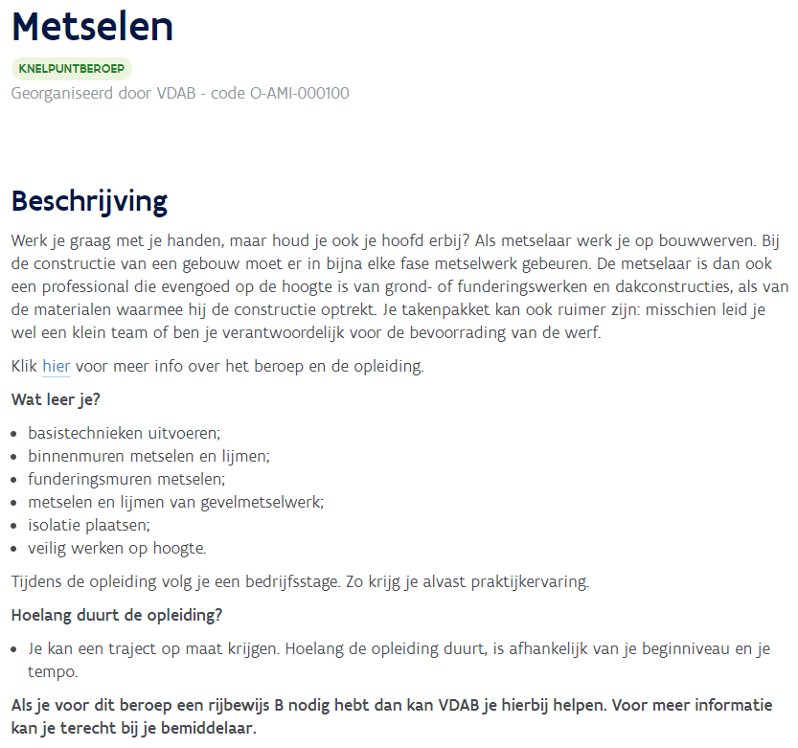
Skills in a training course
bouwwerken
metsen
lijmen
werken op hoogte
isolatietechnieken
…

Slide 39
We also need…
A language that expresses skills: what am I capable of, do I know, …?
Links between occupations and skills: what do I need for this occupation?
Links between training programs and skills: what can I learn?
A method to suggest relevant training: which courses fit my needs?

Slide 40
Training suggestions
Three sets of skills
Citizen: which skills do I already have?
Occupation: which skills do I need ?
Training: which skills can I learn?
Each training course will be scored based on
Which missing skills are learned?
Number of skills in the course that the citizen already knows
Suggested training courses:
top-x with the highest score based on the skill profile and skill distance of the client
Citizen
Occupation
Training

Slide 41
Now we have…
A language that expresses skills: what am I capable of, do I know, …?
Links between occupations and skills: what do I need for this occupation?
Links between training programs and skills: what can I learn?
A method to suggest relevant training: which courses fit my needs?

Slide 42
Jobbereik
https://jobbereik.vdab.be

Slide 43
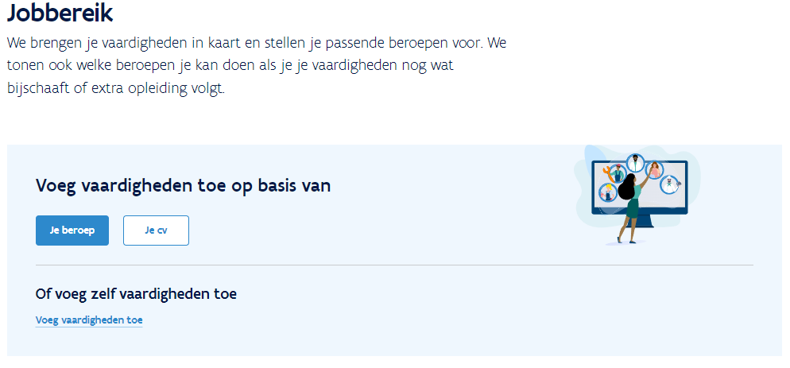
Jobbereik: skill based labour market orientation

Slide 44
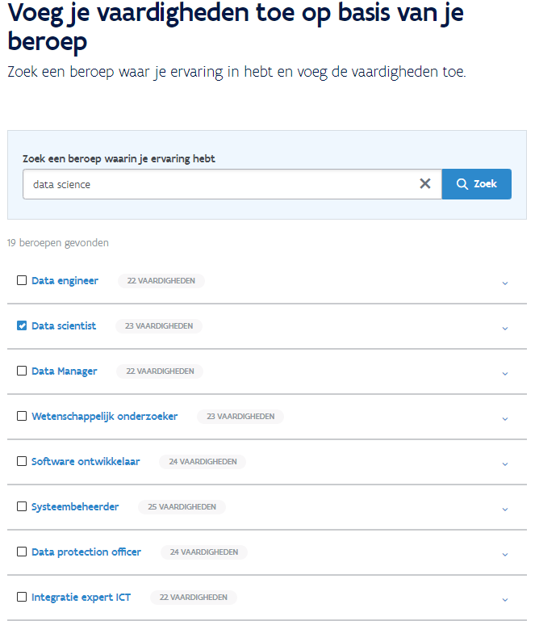
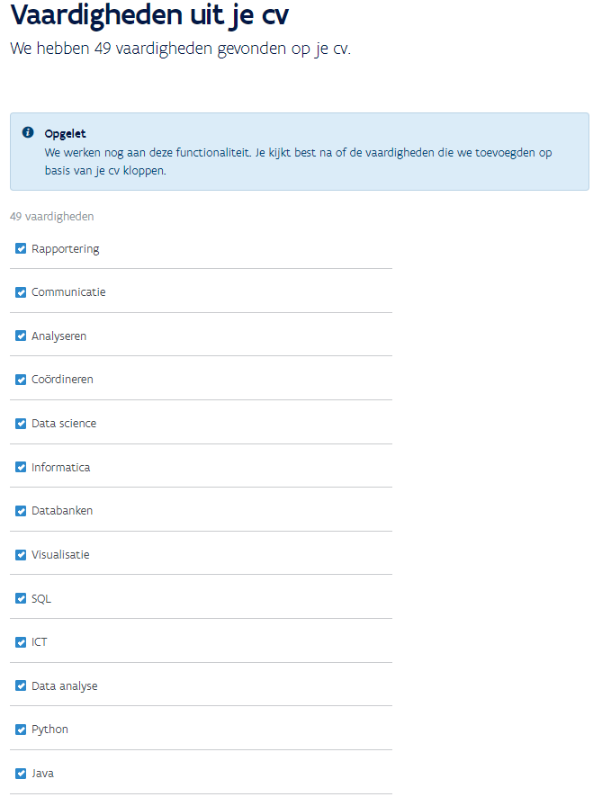
Fast creation of a skill profile based on
work experience or a CV

Slide 45
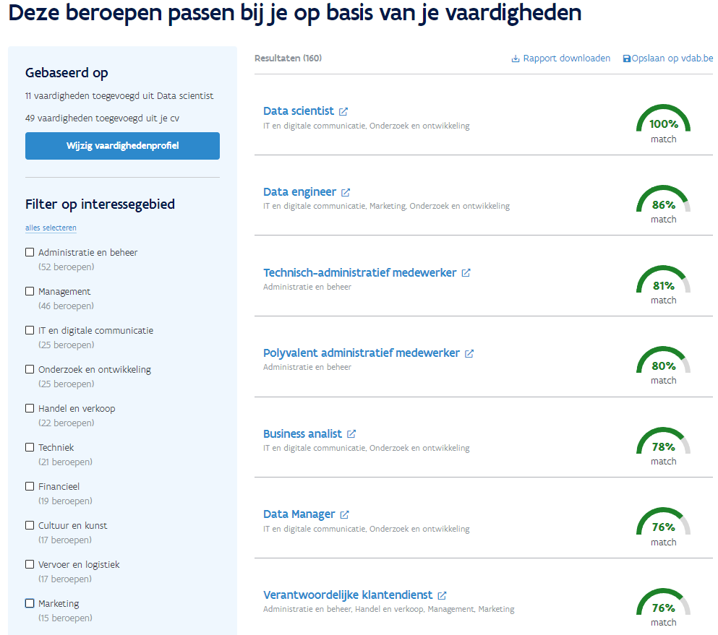
Instant overview of matching occupations

Slide 46
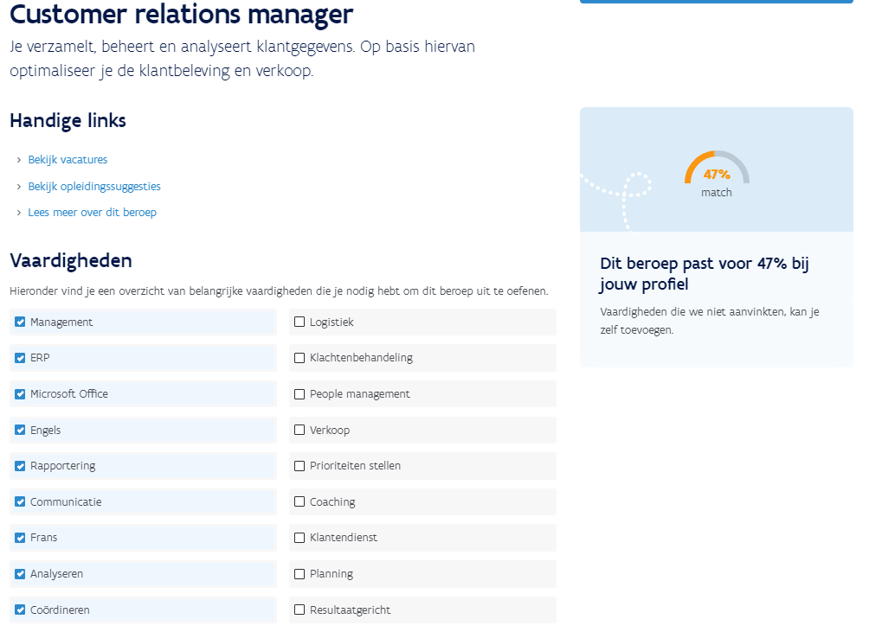
Detailed view of an occupation of interest

Slide 47
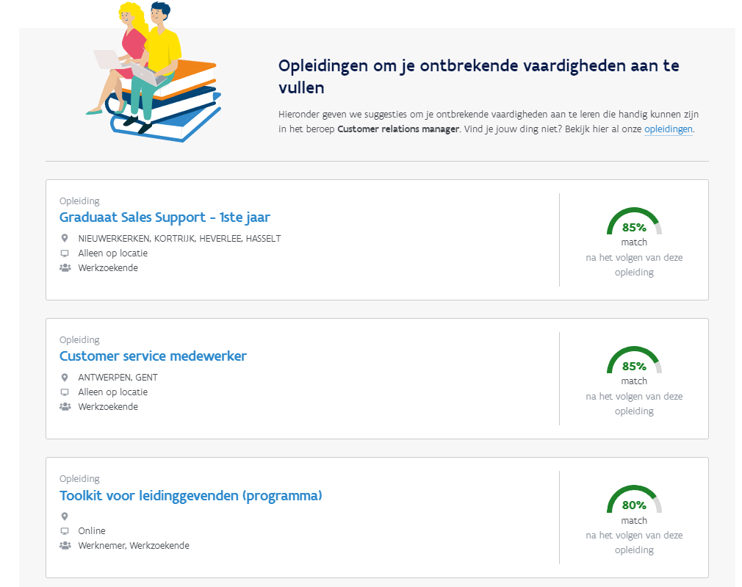
Accompanied by training suggestions

Slide 48
Suggestions regarding citizens with large distance to labour market?

